Slide 1
Medicare Advantage Provider Orientation

Slide 2
Overview of Medicare Advantage
BSW SeniorCare Advantage is a Medicare Advantage product with multiple plan options
All BSW SeniorCare Advantage plan options include medical coverage (Medicare Parts A and B)
Most BSW SeniorCare Advantage plans also include Prescription Drug coverage (Medicare Part D)
Covers all Original Medicare services, PLUS includes vision, hearing, and dental
Follows the Centers for Medicare & Medicaid Services (CMS) guidelines
Members may be responsible for copayments, deductibles, and coinsurance based on the plan that they select

Slide 3
Overview of Medicare Advantage (Continued)
Qualified Medicare Beneficiaries (QMBs) are members that are eligible for both Medicare and Medicaid
Federal law prohibits Medicare Advantage providers from collecting Medicare Part A and Part B deductibles, coinsurance, or copayments from those enrolled in the QMB program, a dual-eligible program that exempts individuals from Medicare cost-sharing liability
Balance billing prohibitions may apply to other dual-eligible beneficiaries in Medicare Advantage plans if the State Medicaid Program holds these individuals harmless for Part A and Part B cost-sharing
Balance billing prohibitions apply regardless of whether the State Medicaid Program is liable to pay the full Medicare cost-sharing amounts

Slide 4
Overview of Medicare Advantage (Continued)
Providers must accept the Medicare Advantage payment as payment in full or bill the State for applicable Medicare cost-sharing for enrollees that are eligible for both Medicare and Medicaid
This federal law applies to all Medicare Advantage providers and not just those that accept Medicaid
Medicare Advantage health providers may not refuse to serve enrollees because they receive assistance with Medicare cost-sharing from a State Medicaid program.
References: 42 CFR §422.504(g)(1)(iii); CMS Managed Care Manual, Chapter 4, Section 10.2.3 & 10.2.5

Slide 5
Overview of Medicare Advantage (Continued)
No out-of-network benefits, except for urgent and emergent care for BSW SeniorCare Advantage HMO
BSW SeniorCare Advantage PPO includes out-of-network benefits with a separate cost-sharing fee schedule
BSW SeniorCare Advantage HMO members must be referred to an in-network provider
BSW SeniorCare Advantage PPO members must be referred to an in-network provider to be eligible for in-network cost sharing
Participating Provider Agreement language:
  Except in Emergency Care situations, for fully insured and Medicare replacement plans, a pre-condition to a healthcare service or product being a Covered Service may be that the service be provided by a Participating Provider, whether it be an individual or a facility. For such plans, absent an Emergency or approval of a BSWHP Medical Director, Provider will make referrals and admit Covered Persons only to Participating Providers.

Slide 6
Overview of Medicare Advantage (Continued)
Contracted providers are expected to coordinate care or work with BSWHP/BSWIC prior to referring a member to a non-contracted provider to ensure, to the extent possible, that members are receiving medically necessary services that are covered by their Medicare Advantage plan.
Current Medicare Advantage providers will be part of both networks regardless of whether the provider is in Central Texas or North Texas
  BSW SeniorCare Advantage HMO (Central and North Texas)
  BSW SeniorCare Advantage PPO (Central and North Texas)
Detailed benefit information for each plan is located on the website BSWHealthPlan.com/Medicare.

Slide 7

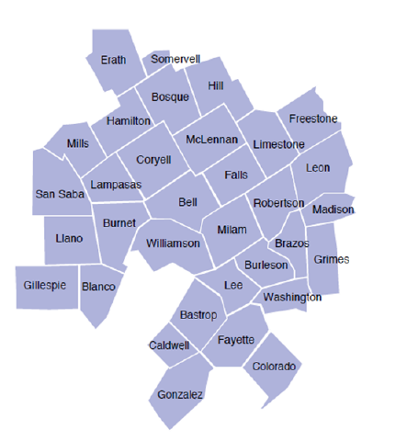
BSW SeniorCare Advantage
Central Texas HMO Service Area

Slide 8
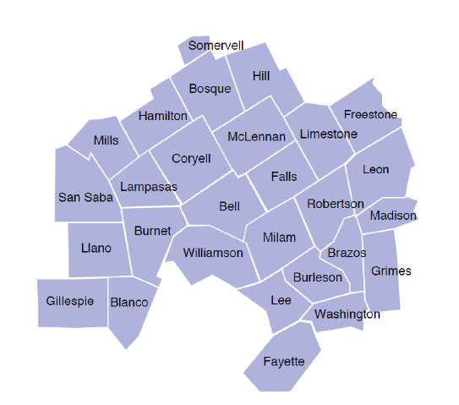
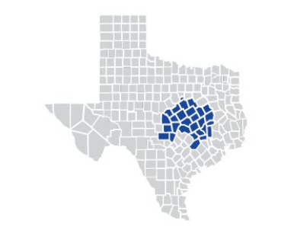
BSW SeniorCare Advantage
Central Texas PPO Service Area

Slide 9
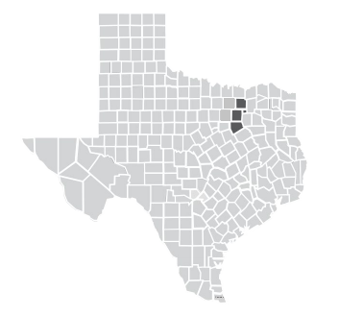
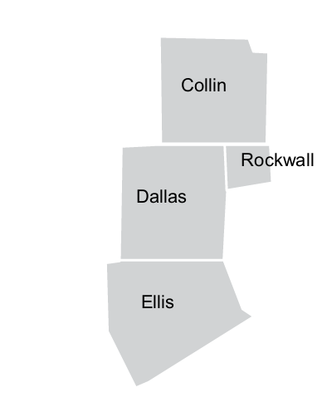
BSW SeniorCare Advantage
North Texas HMO Service Area

Slide 10
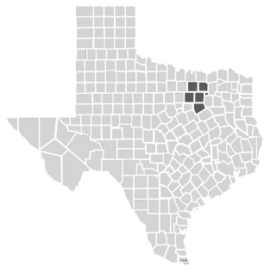

BSW SeniorCare Advantage
North Texas PPO Service Area

Slide 11
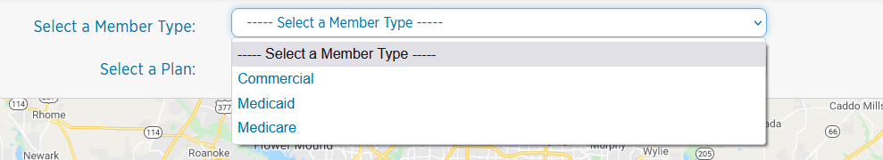
Find a Provider Search
Find a Provider Search: BSWHealthPlan.com/#/search
Select Member Type From Drop Down Menu
Select Plan Name From Drop Down Menu

Slide 12
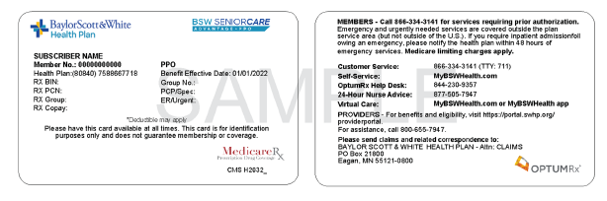
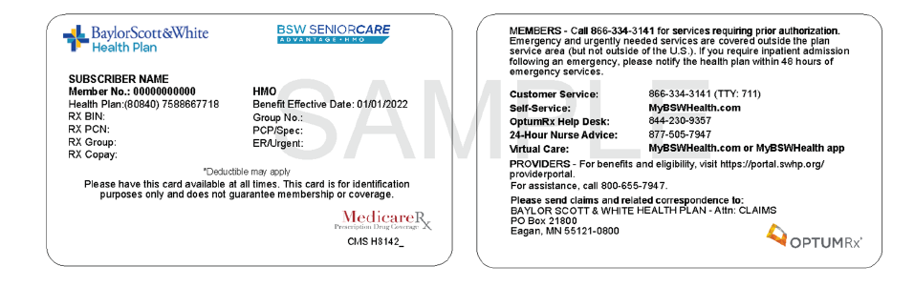
Medicare Advantage Member ID Cards
Baylor Scott & White Health Plan offers HMO and PPO Medicare Advantage plans. These plans provide all the benefits of Original Medicare but may include extra benefits such as vision, hearing, fitness, and dental, depending on the plan.

Slide 13

BSWHP Website
Find a Provider Search: BSWHealthPlan.com/prov
The BSWHP website is a valuable resource for providers to obtain information on the following:
Claims & Billing
Prior Authorizations
Provider Services
Resources
Forms & Guides
Quality Improvement
Policies
Member Eligibility & Benefits

Slide 14
Provider Account Management
Join Our Network Form
  You must be enrolled in Medicare to participate in the Medicare Advantage network.
  BSWHealthPlan.com/prov/services/join
Add Provider to Existing Contract Form
  BSWHealthPlan.com/forms/html/add-provider-to-contract-request.html
Provider Demographic Update Form
  Physical Address change, Billing address change, additional locations, phone number, email address
  BSWHealthPlan.com/forms/html/demographic-Update-Form.html
Modify Existing Contract Form
  Add networks, change of ownership, TIN change, add CPT codes
  BSWHealthPlan.com/forms/html/modify-existing-contract.html
Terminate Provider Contract Form
  BSWHealthPlan.com/forms/html/termination-provider-form.html
Add New Facility
  BSWHealthPlan.com/forms/html/Add-new-facility.html

Slide 15
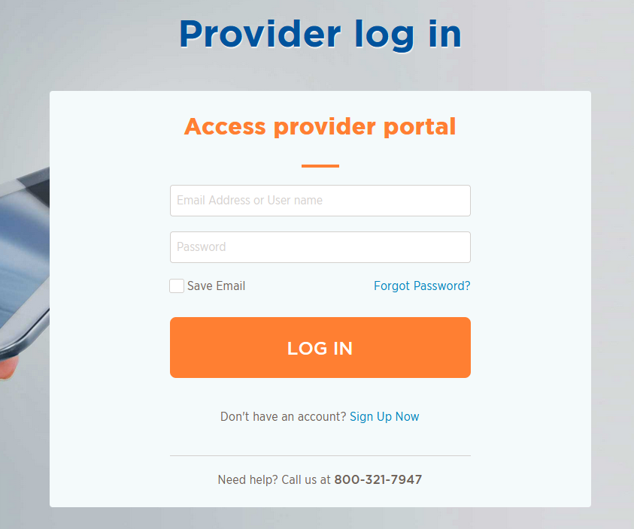
BSWHP Provider Portal
Providers can access the BSWHP Provider Portal at: BSWHealthPlan.com/ProviderPortal/#/login
BSWHP Provider Portal can be utilized for the following:
  Check Member Eligibility & Benefits
  Check Claims & Payment Status
  Look up Codes to Determine Prior Authorization Requirements
  View Explanation of Claim Denial Codes
  Look Up Reimbursement Rates by Code
  Submit Case Management Referral Forms
  Submit Prior Authorization Request Forms
  Add Additional Provider to Active Portal Account
  Add Additional Provider to an Existing Registration (using individual NPI’s)
  Submit Redeterminations

Slide 16
Provider Claims & Billing
Electronic Claims
BSWHP encourages providers to submit claims electronically
Accept direct Electronic Data Interchange (EDI) or Availity Clearinghouse submissions
Electronic claims can be submitted to Payer ID: 88030
Details at BSWHP website: BSWHealthPlan.com/prov/claims-and-billing
Paper Claims
BSWHP will accept paper claims that are properly filed on UB-04 or CMS 1500 Claims Forms
  All claim forms must be typed; handwritten forms are not accepted
  Faxed claim forms are not accepted
  Paper claims can be mailed to:
Baylor Scott & White Health Plan
ATTN: Claims Department
PO Box 21800
Eagan, MN 55121-0800
Details at BSWHP website: BSWHealthPlan.com/prov/claims-and-billing#claim-billing-forms

Slide 17
Provider Claims & Billing (Continued)
Claims Processing Times
Electronic claims are processed within 30 days; paper claims within 45 days
BSWHP encourages the billing of claims electronically for faster payment
Rejected Claims
Electronic Claims
  Providers should review the clearinghouse rejected claims report to determine why the claims were returned to them through their billing system
Paper Claims
  Rejected paper claims are returned with a paper rejection letter
  Providers are encouraged to work rejected claims timely and resubmit within the filing deadline: 365 days for Medicare

Slide 18
Redeterminations
Definition:
  The review of a previously adjudicated/processed claim at the request of a provider to assess if the original determination/decision was correct or should be reversed based on additional information not previously available during the original determination. More information available at: BSWHealthPlan.com/en-us/prov/claims-and-billing
Process:
Providers must submit the Provider Claim Redetermination Request Form located at: BSWHealthPlan.com/prov/claims-and-billing
Providers may submit the form electronically through the provider portal.
Providers or inquiring parties will have only one opportunity to submit a redetermination request. Multiple requests submitted on a single claim will not be processed and will be returned as “previously reviewed.”
Provider should attach any pertinent supporting documentation i.e. retro authorization, proof of timely filing, surgical notes, office visit notes, pathology reports, and/or medical records.
Requests for Redeterminations must be submitted within 120 days for Medicare Advantage Claims

Slide 19
Provider Appeals & Complaints
Appeals
Definition: Provider, on behalf of the member, or Member requests reconsideration of an adverse determination related to a request for medical services such as a prior authorization request.
Complaints
Definition: member or provider expression of any dissatisfaction.
Process
Contact customer service to file an appeal or complaint with a Customer Service Advocacy agent. The agent will route the appeal or complaint to the appropriate area.
Process is the same for appeals and complaints.
Customer service phone number 800.321.7947 or 254.298.3000.

Slide 20
Provider Payment Options
BSWHP offers the following payment options through Change Healthcare:
Virtual Credit Card (VCC)
  Providers can receive payment by processing it as a credit card; funds are immediately available; fees may be assessed
  If payment is not accepted within 90 days, a paper check will be mailed
  Provider will have to opt out of this method if they choose to utilize another payment method
  To opt out of the VCC payment method, please contact Change Healthcare at 866.506.2830 –
  select option 1.
  To select Automatic Clearinghouse (ACH) or Electronic Funds Transfer (EFT), visit ChangeHealthcare.com\EFT
Electronic Funds Transfer (EFT)
  Payments are sent directly to the provider’s bank; typically received within 3 – 5 business days
Paper Check
  A paper check is mailed to the provider’s billing or claims payment address on file

Slide 21
Account Reconciliation (Retractions/Recoupments)
BSWHP is dedicated to identifying and resolving accounting issues in a timely manner
Proper documentation will result in error reduction, which will result in quicker payments
Retractions/Recoupments:
Retractions/recoupments are made for various reasons, including:
  Duplicate payment on a procedure
  Incorrect payment on a procedure
  Payment to the wrong provider
To initiate a retraction, please complete a Provider Appeal Request Form located at: BSWHealthPlan.com/ProviderPortal/#/0/Files/Forms/Providers/Claims%20Forms/ProviderClaimAppealRequestForm_4.pdf

Slide 22
Account Reconciliation (Returned/Refund Checks)
Returned Checks
If a BSWHP check is returned for an adjustment, attach all documentation with an explanation for the returned payment
  Be sure to include a copy of the Explanation of Payment (EOP), copies of prior payments, and any other documentation explaining the payment discrepancy
Refund Checks
For all BSWHP member claims, providers should send refund checks to the following address to reimburse money owed to BSWHP:
Baylor Scott & White Health Plan
ATTN: Claims Adjustment Department
PO Box 840523
Dallas, TX 75284-0523

Slide 23
Quality Improvement (QI) Program
Ensures BSWHP is providing the highest quality of care that is easy to access and affordable to our members
“Triple Aim” Goal: improving member’s affordability, quality, and experience of care
Quality programs and improvement projects are designed to improve member outcomes through systematic ongoing measurement, care coordination, and continuous evaluation of results
For more information on the QI Program, please visit the BSWHP website at: BSWHealthPlan.com/prov/resources/provider-manual/quality-improvement

Slide 24
Healthcare Effectiveness Data and Information Set (HEDIS)
HEDIS is a tool used by more than 90% of U.S. health plans to measure performance on important dimensions of care and service
Altogether, HEDIS consists of 95 measures across seven domains of care
BSWHP uses HEDIS to measure clinical quality performance and evaluate the following areas of care:
  Preventive services
  Treatment of acute illness
  Management of chronic illnesses
For more information on HEDIS, please visit the BSWHP website at: BSWHealthPlan.com/prov/resources/provider-manual/quality-improvement

Slide 25
Medicare Star Rating
What is the Medicare Star Rating System?
CMS’ rating system for evaluating the relative quality of Medicare plans
All plans are measured on a scale of 1 to 5 Stars, with 5 Stars representing the highest quality
CMS defines the Star Ratings as follows:
  5 Stars = Excellent performance
  4 Stars = Above average performance
  3 Stars = Average performance
  2 Stars = Below average performance
  1 Star = Poor performance
Every year, Medicare evaluates plans based on a 5-star rating system.

Slide 26
Medicare Star Rating (Continued)
Improved healthcare and quality for our members = Star Ratings
Emphasis on preventive care and adherence will help to minimize acute care needs and decrease readmission rates
What is the impact of higher Star Ratings?
  Richer benefits to our members
  Plans at 5 Stars can market and enroll members year-round
  Improved financial returns
How does a provider impact our Star Ratings?
  Provider performance impacts nearly two-thirds of the Star measures and includes member surveys of provider performance
  Following is a sample of some items for which CMS measures provider performance:
    Appropriate medical care
    Prescription drug management
    Patient experience
    Care coordination

Slide 27
Jimmo v. Sebelius Settlement Agreement
On January 24, 2013, the U.S. District Court for the District of Vermont approved a settlement agreement in the case of Jimmo v. Sebelius. The settlement involves skilled care for skilled nursing facilities (SNFs), home health (HH), inpatient rehabilitation facility (IRF), and outpatient therapy (OPT) benefits.
The settlement agreement is intended to clarify that when skilled nursing or skilled therapy services are required in order to provide care that is reasonable and necessary to prevent or slow further deterioration, coverage cannot be denied based on the absence of potential for improvement or restoration. Conversely, coverage in this context would not be available when the member’s needs can be met safely and effectively through the use of nonskilled personnel.
The Jimmo v. Sebelius settlement agreement does not change existing Medicare coverage requirements. It only serves to clarify that, in the context of maintenance services, coverage does not turn on the presence or absence of potential for improvement, but on the need for skilled care.
For detailed information and frequently asked questions, please visit the Centers for Medicare & Medicaid Services (CMS) website at: CMS.gov/Center/Special-Topic/Jimmo-Center

Slide 28
Health Services Division (HSD)
HSD includes:
Medical Directors
Nurse Managers
Licensed Clinical Social Workers
Administrative Staff
Functions handled by HSD include:
Intake
Utilization Management Review/Prior Authorizations*
Case Management/Complex Case Management
Disease Management
Phone Number: 888.316.7947 or 254.298.3088
Fax Number: 800.626.3042

Slide 29
Pharmacy Services
OptumRx
Pharmacy network utilized by BSWHP (except for Medicaid)
Processes pharmacy claims for BSWHP (except for Medicaid)
BSWHP Prescription Drug Lists (Formularies)
Located on the BSWHP website at: BSWHealthPlan.com/prov/pharmacy-resources
BSWHP Medication Authorizations & Exceptions
Located on the BSWHP website at: BSWHealthPlan.com/prov/medical-resources
Contact Information
OptumRx Help Desk Phone Numbers:
  Commercial plan: 855.205.9182; Medicare Part D plan: 844.230.9357

Slide 30

Drug PA & Appeal Requests – Review Entities
Drug
Initial
PA
Appeal
Medical
Benefit
PHARMACY
Benefit
MEDICAL
Benefit
PHARMACY
Benefit
BSWHP
Health Services
OptumRx
BSWHP
A&G Dept
Commercial
Plans
Medicare Part D
plans
BSWHP
A&G Dept.
OptumRx

Slide 31
Drug PA & Appeal Requests – Submission Details
Pharmacy Benefit Drug Drug to be purchased from pharmacy | Medical Benefit Drug Drug to be billed on a medical claim aka “buy and bill”
Initial and Renewal of PA Request
ONLINE (OptumRx) CoverMyMeds Go.CoverMyMeds.com/OptumRx SureScripts ProviderPortal.SureScripts.net/providerportal/ PreCheck MyScript Provider.LinkHealth.com/#/ | ONLINE (BSWHP) BSWHealthPlan.com/ProviderPortal/#/login
FAX 800.527.0531 (OptumRx) | FAX 800.626.3042 (BSWHP)
Phone Commercial plan: 855.205.9182 (OptumRx) Medicare Part D plan: 844.230.9357 (OptumRx) | Phone 800.321.7947 (BSWHP)
Mail OptumRx Attn: Prior Auth Exceptions P.O. Box 25183 Santa Ana, CA 92799

Slide 32
Drug PA & Appeal Requests – Submission Details
Pharmacy Benefit Drug Drug to be purchased from pharmacy | Medical Benefit Drug Drug to be billed on a medical claim aka “buy and bill”
Appeals and Redeterminations
FAX Commercial plan: 254.298.3663 (BSWHP) Medicare Part D plan: 877.239.4565 (OptumRx) | FAX 254.298.3663 (BSWHP)
Phone Commercial plan: 800.321.7947 (BSWHP) Medicare Part D plan: 888.403.3398 (OptumRx)* | Phone 800.321.7947 (BSWHP)
MAIL: Commercial plan BSWHP c/o Appeals and Grievances 1206 West Campus Drive, Temple, TX 76502 MAIL: Medicare Part D plan OptumRx Prior Authorization Department c/o Appeals Coordinator P.O. Box 25184, Santa Ana, CA 92799 | MAIL BSWHP c/o Appeals and Grievances 1206 West Campus Drive Temple, TX 76502

Slide 33
Fraud, Waste, and Abuse (FWA) Training
CMS requires BSWHP to ensure that our participating providers complete FWA training annually
To address this CMS requirement, BSWHP offers FWA training online at:
  BSWHealthPlan.com /prov/resources/fraud-waste-abuse-training
Providers are also required to attest that they have completed the FWA training
  Medicare FWA Training Attestation Form is located online at:
    BSWHealthPlan.com /providers/resources/fraud-waste-and-abuse-training-providers/fraud-waste-and-abuse-training
BSWHP understands that providers may have already completed FWA training for another Medicare plan or program
  If that is the case, providers are asked to complete the Medicare FWA Training Attestation Form

Slide 34
BSWHP Important Contact Information
Provider Relations
Phone Number: 800.321.7947 or 254.298.3064
Fax Number: 254.298.3044
Email Address:
SWHPProvServices@BSWHealth.org
Health Services Division
Phone Number: 888.316.7947 or 254.298.3088
Fax Number: 800.626.3042
BSWHP Provider Portal: BSWHealthPlan.com/ProviderPortal/#/login
Provider IVR: 800.655.7947
Customer Service Department
Phone Number: 800.321.7947 or 254.298.3000
Part D Prior Authorizations/Appeals:
Coverage Determinations: 844.230.9357

