Slide 1
Commercial Provider
Orientation

Slide 2
ABOUT BAYLOR SCOTT & WHITE HEALTH PLAN
Scott and White HealthPlan started in January 1982 as a nonprofit Health Maintenance Organization. First called Centroplex Health Plan, with a service area focused primarily in Bell and Coryell counties, we have since grown our membership to over 370,000 members and our service area to 171 counties.
As of January 1, 2022, Scott and White Health Plan does business as Baylor Scott & White Health Plan (BSWHP). Subsidiaries include Baylor Scott & White Insurance Company (BSWIC) and Scott & White Care Plans d/b/a Baylor Scott & White Care Plan (BSWCP).
We continue to introduce new plans, technology and services to meet the needs of members, employers, and the community. We currently offer individual and family plans, fully insured and self-funded plans for small and large employers, Medicare Advantage and Prescription Drug plans, and Medicaid plans.

Slide 3
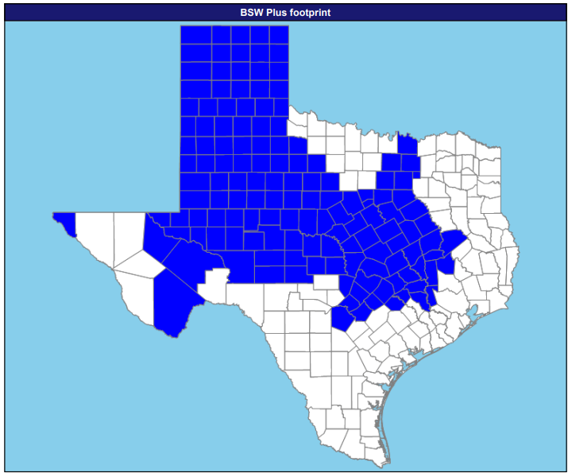
BSW PLUS SERVICE AREA
141 Counties:
Andrews, Armstrong, Austin, Bailey, Bastrop, Bell, Bexar, Blanco, Borden, Bosque, Brazos, Brewster, Briscoe, Brown, Burleson, Burnet, Caldwell, Callahan, Carson, Castro, Childress, Cochran, Coke, Coleman, Collin, Collingsworth, Comal, Comanche, Concho, Coryell, Cottle, Crane, Crockett, Crosby, Dallam, Dallas, Dawson, Deaf Smith, Denton, Dickens, Donley, Eastland, Ector, El Paso, Ellis, Erath, Falls, Fayette, Fisher, Floyd, Freestone, Gaines, Garza, Glasscock, Gray, Grayson, Grimes, Guadalupe, Hale, Hall, Hamilton, Hansford, Hartley, Haskell, Hays, Hemphill, Hill, Hockley, Hood, Houston, Howard, Hutchinson, Irion, Johnson, Jones, Kent, Kimble, King, Knox, Lamb, Lampasas, Lee, Leon, Limestone, Lipscomb, Llano, Loving, Lubbock, Lynn, Madison, Martin, Mason, McCulloch, McLennan, Menard, Midland, Milam, Mills, Mitchell, Moore, Motley, Navarro, Nolan, Ochiltree, Oldham, Parmer, Pecos, Potter, Randall, Reagan, Reeves, Roberts, Robertson, Rockwall, Runnels, San Saba, Schleicher, Scurry, Shackelford, Sherman, Somervell, Stephens, Sterling, Stonewall, Sutton, Swisher, Tarrant, Taylor, Terry, Throckmorton, Tom Green, Travis, Upton, Walker, Waller, Ward, Washington, Wheeler, Williamson, Winkler, Yoakum,

Slide 4
COMMERCIAL
BSWHP offers HMO plans for individuals and families, small groups, and TPA/ASO accounts
  Utilizes the BSWHP network with no out-of-network (OON) benefits; OON providers are not covered except in an emergency
BSWIC offers PPO plans
  Utilizes the BSWIC network with OON benefits; OON providers are covered, but at a higher cost share for members
BSWCP offers HMO plans for large groups
Baylor Scott & White Preferred HMO/PPO
BSW Preferred (BSWQA participation/decisions) independent of Tiers (HR decisions)

Slide 5
PROVIDER WEBSITE
BSWHealthPlan.com is a valuable resource for providers to obtain information on the following:
Claims & Billing
Forms & Guides
Prior Authorizations
Quality Improvement
Provider Services
Policies
Resources
Member Eligibility & Benefits

Slide 6
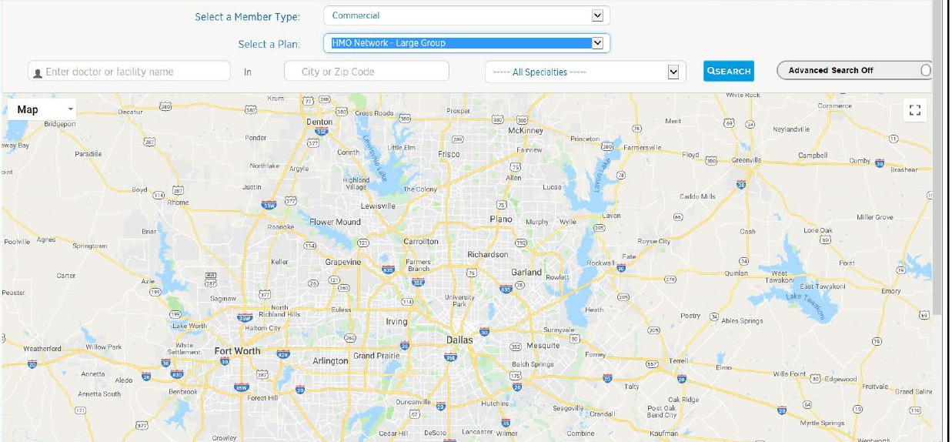
“FIND A PROVIDER” SEARCH TOOL
Find a Provider Search: BSWHealthPlan.com

Slide 7
PROVIDER CONTRACTING AND SERVICES
Visit BSWHealthPlan.com for the following forms:
Join Our Network Form
Add Provider to Existing Contract Form
Provider Change of Address Form
Modify Existing Contract Form
Terminate Provider Contract Form

Slide 8
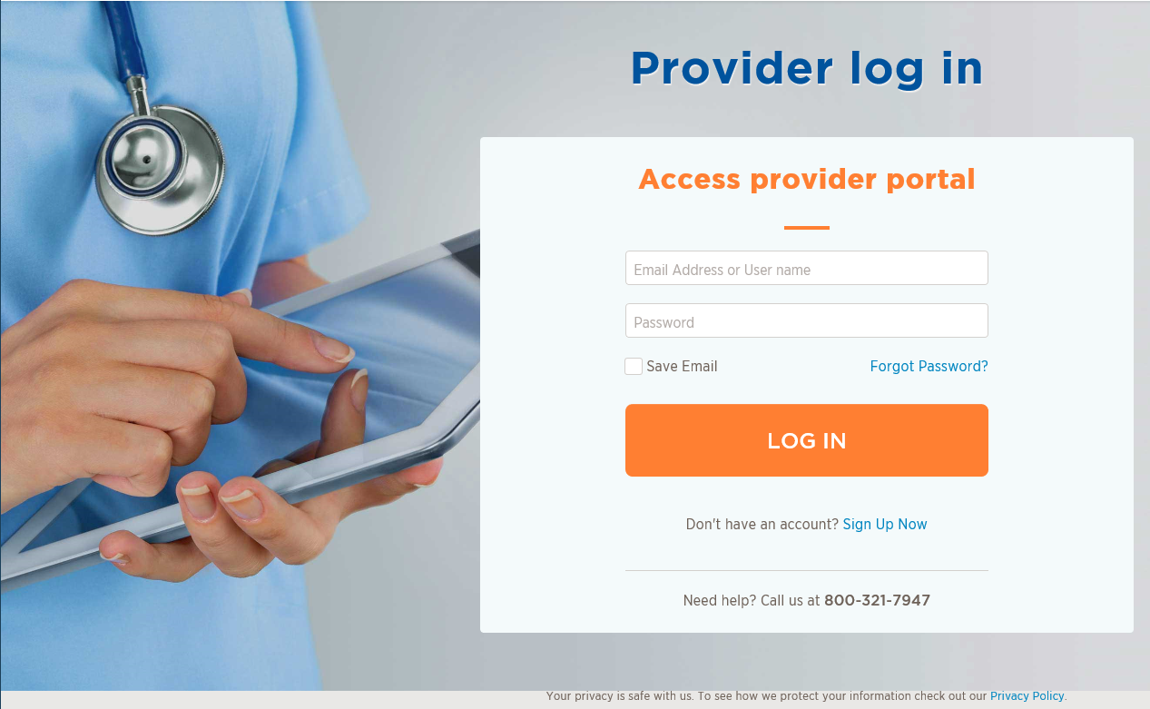
PROVIDER PORTAL
Check member eligibility & benefits
Check claims & payment status
Look up codes to determine Prior Authorization requirements
View claim denial codes
Search reimbursement codes
Submit case management referrals
Submit Prior Authorization requests
Register as a group provider
Add provider to an existing registration (using individual NPIs)
Submit redeterminations

Slide 9
CLAIMS AND BILLING
Electronic Claims
BSWHP strongly encourages providers to submit claims electronically
Accept direct Electronic Data Interchange (EDI) submissions or submissions through Availity Clearinghouse
Electronic claims can be submitted to Payer ID: 88030
Details at BSWHP website: BSWHealthPlan.com
Paper Claims
BSWHP will accept paper claims that are properly filed on UB-04 or CMS 1500 Claims Forms
All claim forms must be typed; handwritten forms are not accepted
Faxed claim forms are not accepted
Paper claims can be mailed to:
Baylor Scott & White Health Plan ATTN: Claims Department
PO Box 21800 Eagan, MN 55121-0800
Additional information: BSWHealthPlan.com

Slide 10
CLAIMS AND BILLING (CONT’D)
Claims Processing Times
BSWHP follows the Texas Department of Insurance (TDI) regulation for the processing of claims
Electronic claims are processed within 30 days; paper claims within 45 days
BSWHP encourages the billing of claims electronically for faster payment
Rejected Claims
Electronic Claims
  Providers should review the clearinghouse rejected claims report to determine why the claims were returned to them through their billing system
Paper Claims
  Rejected paper claims are returned with a paper rejection letter
  Providers are encouraged to work rejected claims timely and resubmit within the filing deadline: 365 days for Medicare

Slide 11
REDETERMINATIONS
Definition
The review of a previously adjudicated / processed claim at the request of a provider to assess if the original determination/decision was correct or should be reversed based on additional information not previously available during the original determination. More information available on the BSWHP website at: BSWHealthPlan.com
Process
Providers must submit the Provider Claim Redetermination Request Form located on the BSWHP website
Providers now have the option to submit the Claim Redetermination Request Forms electronically through the provider portal.
Providers or inquiring parties will have only one (1) opportunity to submit a redetermination request on a claim. Multiple requests submitted on a single claim will not be processed and will be returned as “previously reviewed.”
Provider should attach any pertinent supporting documentation i.e. retro authorization, proof of timely filing, surgical notes, office visit notes, pathology reports, and/or medical records.
Requests for Redeterminations must be submitted within 90 days from the original determination date. (120 days for Medicare Advantage Claims; 1 year for out-of-state providers).

Slide 12
APPEALS AND COMPLAINTS
Appeals
Definition: Provider, on behalf of the member, or Member requests reconsideration of an adverse determination related to a request for medical services such as a prior authorization request.
Complaints
Definition: member or provider expression of any dissatisfaction.
Process
Contact customer service to file an appeal or complaint with a Customer Service
Advocacy agent. The agent will route the appeal or complaint to the appropriate area. *Process is the same for appeals and complaints. Customer service phone number (800)321-7947 or (254)298-3000.

Slide 13
PROVIDER PAYMENT OPTIONS
BSWHP offers the following payment options through Change Healthcare
Virtual Credit Card (VCC)
  Providers can receive payment by processing it as a credit card; funds are immediately available; fees may be assessed
  If payment is not accepted within 90 days, a paper check will be mailed
  Providers will have to opt out of this method if they choose another payment method
    To opt-out of the VCC payment method, please contact Change Healthcare at 866-506-2830 – select option 1.
    To select Automatic Clearinghouse (ACH) or Electronic Funds Transfer (EFT), visit www.changehealthcare.com\EFT
Electronic Funds Transfer (EFT)
  Payments are sent directly to the provider’s bank; typically received within 3-5 business days
Paper Check
  A paper check is mailed to the provider’s billing or claims payment address on file

Slide 14
ACCOUNT RECONCILIATION
(RETRACTIONS/RECOUPMENTS)
BSWHP is dedicated to identifying and resolving accounting issues in a timely manner
Proper documentation will result in error reduction, which will result in quicker payments
Retractions/Recoupments:
Retractions/recoupments are made for various reasons, including:
  Duplicate payment on a procedure
  Incorrect payment on a procedure
  Payment to the wrong provider
To initiate a retraction, complete a Provider Appeal Request Form located at: BSWHealthPlan.com

Slide 15
ACCOUNT RECONCILIATION
(RETURNED/REFUND CHECKS)
Returned Checks
If a BSWHP check is returned for an adjustment, attach all documentation with an explanation for the returned payment
Include a copy of the Explanation of Payment (EOP), copies of prior payments, and any other documentation explaining the payment discrepancy
Refund Checks
For all BSWHP member claims, providers should send refund checks to the following address to reimburse money owed to BSWHP:
          Baylor Scott & White Health Plan
          ATTN: Claims Adjustment Department
          PO Box 840523
          Dallas, TX 75284-0523

Slide 16
IN-NETWORK REFERRALS
BSWHP members must be referred to an in-network provider.
BSWHP Participating Provider Agreement language:
  Except in Emergency Care situations, for fully insured and Medicare replacement plans, a pre-condition to a healthcare service or product being a Covered Service may be that the service be provided by a Participating Provider, whether it be an individual or a facility. For certain plans, absent an Emergency or approval of a Medical Director, Provider will make referrals and admit Covered Persons only to Participating Providers.
To locate an in-network provider:
  Use online provider search (Find a Provider) located on the BSWHP website at: BSWHealthPlan.com

Slide 17
COORDINATION OF BENEFITS (COB)
COB Definition:
  Standards advocated by the National Association of Insurance Commission (NAIC) that determines the obligation of payers when a member is covered under two or more health insurance policies
  When there is duplicate coverage, COB standards determine who pays primary and who pays secondary
  Fully insured plans follow Texas Department of Insurance (TDI) COB requirements.
BSWHP coordinates benefits payable for covered services with benefits payable by other plans consistent with state law.
More information on COB available on the BSWHP website at: BSWHealthPlan.com

Slide 18
QUALITY IMPROVEMENT (QI) PROGRAM
Ensures BSWHP is providing the highest quality of care that is easy to access and affordable to our members
“Triple Aim” Goal: improving member’s affordability, quality, and experience of care
Quality programs and improvement projects are designed to improve member outcomes through systematic ongoing measurement, care coordination, and continuous evaluation of results
For more information on the QI Program, please visit the BSWHP website at: BSWHealthPlan.com

Slide 19
HEALTHCARE EFFECTIVENESS DATA AND
INFORMATION SET (HEDIS)
HEDIS is a tool used by more than 90% of U.S. health plans to measure performance on important dimensions of care and service.
Altogether, HEDIS consists of 95 measures across 7 domains of care.
BSWHP uses HEDIS to measure clinical quality performance and evaluate the following areas of care:
  Preventive services
  Treatment of acute illness
  Management of chronic illnesses
For more information on HEDIS, please visit the BSWHP website at: BSWHealthPlan.com

Slide 20
NATIONAL COMMITTEE FOR QUALITY
ASSURANCE (NCQA)
NCQA Accreditation is a comprehensive evaluation of health plans’ clinical and consumer experience measures.
Standards are developed with the help of health plans, providers, insurance customers, unions, regulatory agencies, and consumer groups.
NCQA’s Health Plan Accreditation is considered the industry’s gold standard.
NCQA Accreditation measures 5 areas of performance:
  Staying healthy
  Getting better
  Living with illness
  Access and service
  Qualified providers
For more information on NCQA, please visit the BSWHP website at: BSWHealthPlan.com

Slide 21
HEALTH SERVICES DIVISION (HSD)
HSD includes:
  Medical Directors
  Nurse Managers
  Licensed Clinical Social Workers
  Administrative Staff
Functions handled include:
  Intake
  Utilization Management Review/Prior Authorizations*
  Case Management/Complex Case Management
  Disease Management
Phone: (888) 316-7947 or (254) 298-3088
Fax: (800) 626-3042
* Prior Authorizations can now be requested through the provider portal.

Slide 22
PHARMACY SERVICES
OptumRx
  Pharmacy network utilized by BSWHP (except for Medicaid)
  Processes pharmacy claims for BSWHP (except for Medicaid)
BSWHP Prescription Drug Lists (Formularies)
  Located on the BSWHP website at:
BSWHealthPlan.com
BSWHP Medication Authorizations & Exceptions
  Located on the BSWHP website at:
BSWHealthPlan.com
Contact Information
  Help Desk Phone Number: 1-844-230-9357

Slide 23
FRAUD, WASTE AND ABUSE (FWA)
Baylor Scott & White Health Plan (BSWHP) expects providers to play a vital role in fighting against fraud, waste, and abuse (FWA). Healthcare providers are required to know how to correctly: 1) Identify methods of preventing FWA 2) Identify how to report FWA 3) Recognize how to correct FWA.
BSWHP Special Investigations Unit (SIU) detects and prevents FWA through claims quality/accuracy assessment, screening for individuals who are excluded from participating in federal healthcare programs and investigating reports to the compliance helpline.
Efforts include, but are not limited to prepayment claims editing, post payment claim audits, data analysis and trending, and FWA trainings.
Join efforts to prevent FWA by reporting unethical practices, including concerns about potential member fraud using one of the below reporting options:
Contact Compliance Department: BSWHPComplianceDepartment@bswhealth.org
Call Compliance Helpline: 1-866-245-0815
Visit Website: BSWHealthPlan.com
Mail to: Attention SIU Department, 1206 West Campus Drive Temple, TX 76502

Slide 24
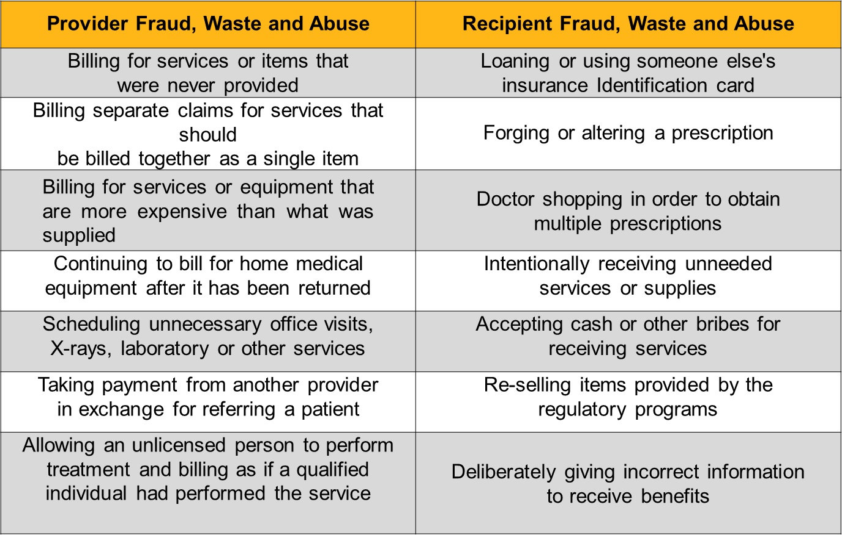
EXAMPLES OF FRAUD, WASTE AND
ABUSE (FWA)

Slide 25
IMPORTANT CONTACT INFORMATION
Area | Phone | Fax | Email
Provider Relations | 800.321.7947 or 254.298.3064 | 254.298.3044 | SWHPProviderRelationsDepartment@bswhealth.org
Health Services | 888.316.7947 or 254.298.3088 | 800.626.3042
Pharmacy | 800.728.7947 | 254.298.6110 | PrescriptionServices@bswhealth.org
Compliance | 866.245.0815 |  | SWHPComplianceDepartment@bswhealth.org
Customer Advocacy | 800.655.7947
Provider IVR | 800.655.7947
Change Healthcare (to opt out of Virtual Credit Card/VCC) | 855.886.2830 Option 1

